Slide 1
HORMONES AND HORMONE ANTAGONISTS-III
THYROID HORMONES & MISCELLANEOUS
R.M., SRSV

Slide 2
Goitrogens
Goitrogens are agents that suppress secretion of T3 and T4 to subnormal levels and thereby increase TSH, which in turn produces glandular enlargement (goitre). This in turn stimulates the thyroid which shows hypertrophy, hyperplasia and increase in vascularity.
Classification of goitrogens:-
1. Ion inhibitors: Ex:- potassium perchlorates, thiocyanates
2. Organic antithyroid drugs:
a. Thioamide derivatives: Ex: propyl thiouracil, carbimazole, methimazole
b. Misc: sulfonamides, PAS, resorcinol, amine glutethimide.

Slide 3
Goitrogens
3.Mineralocorticoids:
(Aldosterone, Deoxycorticosterone, Fludrocortisone) Mineralocorticoids act by binding to mineralocorticoid receptor in cytoplasm of target cells, the principal cells of distal convoluted and collecting tubules of kidney. The major effect of activation of aldosterone receptor is increased expression of Na+/K+ ATPase and epithelial sodium channel (ENaC).
a. Aldosterone and other steroids with mineralocorticoid properties promote reabsorption of sodium from distal convoluted tubule and from cortical collecting renal tubules, loosely coupled to excretion of potassium and hydrogen ion. Sodium reabsorption in sweat, salivary glands, gastrointestinal mucosa, and across cell membranes is also increased.

Slide 4
Goitrogens
b. Deoxycorticosterone (DOC) serves as a precursor of aldosterone. Its half-life is 70 minutes. Although the response to ACTH is enhanced by dietary sodium restriction, a low-salt diet does not increase DOC secretion. The secretion of DOC may be markedly increased in abnormal conditions such as adrenocortical carcinoma and congenital adrenal hyperplasia with reduced P450c11 or P450c17 activity.
c. Fludrocortisone, a potent steroid with both glucocorticoid and mineralocorticoid activity. It has potent salt-retaining activity and used in treatment of adrenocortical insufficiency associated with mineralocorticoid deficiency.

Slide 5
Antithyroid drugs
Classification:
1. Thioamide derivatives Ex: propyl thiouracil, carbimazole, methimazole
2. Radioactive iodine Ex: Iodine I131
3. Iodides Ex: Lugol’s solution
4. Anion inhibitors Ex: perchlorates, thiocyanates
5. Iodinated contrast media Ex: oral ipodate and ipanoid acid, diatrizoate.

Slide 6
Antithyroid drugs
The thioamides like methimazole, carbimazole and propylthiouracil are major drugs for treatment of thyrotoxicosis.
Pharmacodynamics: The thioamides act by multiple mechanisms. The major action is to prevent hormone synthesis by inhibiting the thyroid peroxidase-catalyzed reactions and blocking iodine organification. In addition, they block coupling of the iodotyrosines. They do not block uptake of iodide by the gland. Propylthiouracil and methimazole inhibit peripheral deiodination of T4 and T3. Since, synthesis rather than the release of hormones is affected, the onset of these agents is slow, often requiring 3–4 weeks before stores of T4 are depleted.

Slide 7
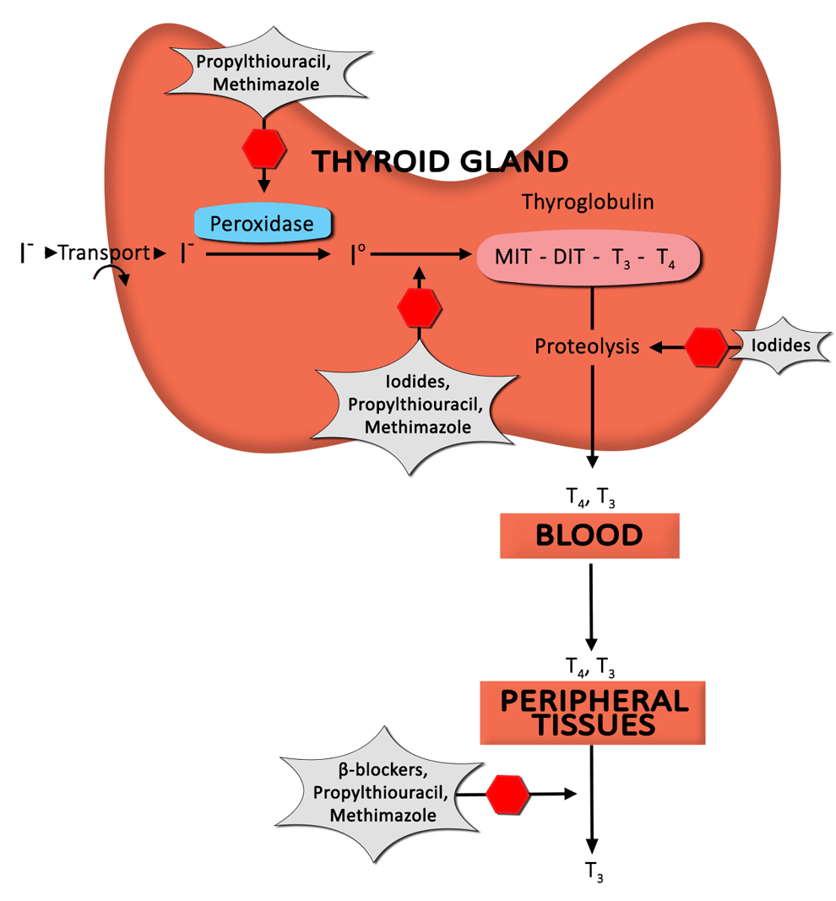
Antithyroid drugs
Schematic diagram of mechanism of action of Antithyroid drugs is shown below:

Slide 8
Antithyroid drugs
Pharmacokinetics: Propylthiouracil is rapidly absorbed, reaching peak serum levels after 1 hour. The bioavailability of 50–80% may be due to incomplete absorption or a large first-pass effect in the liver. The volume of distribution approximates total body water with accumulation in the thyroid gland. Excreted by kidney as inactive glucuronide within 24 hours.
Therapeutic Uses: The antithyroid drugs are used in treatment of hyperthyroidism in following three ways: (1) as definitive treatment, to control disorder in anticipation of spontaneous remission in Graves' disease; (2) in conjunction with radioactive iodine, to hasten recovery while awaiting effects of radiation; and (3) to control the disorder in preparation for surgical treatment.

Slide 9
Antithyroid drugs
Toxicity: Nausea and gastrointestinal distress, maculopapular pruritic rash, and fever occur in 3–12% of treated patients.
Rare adverse effects include an urticarial rash, vasculitis, a lupus-like reaction, lymphadenopathy, hypoprothrombinemia, exfoliative dermatitis, polyserositis, and acute arthralgia. Hepatitis and cholestatic jaundice can be fatal; although asymptomatic elevations in transaminase levels also occur.

Slide 10
Uterine stimulants
Drugs and hormones used clinically to enhance uterine contractions are primarily employed either to induce or to augment contraction during deliver or at various stages of labour. Ex: Oxytocin, Ergot alkaloids, and prostaglandins.
Oxytocin is a peptide hormone secreted by posterior pituitary that participates in labor and delivery and elicits milk ejection in lactating women. During the second half of pregnancy, uterine smooth muscle shows an increase in expression of oxytocin receptors and becomes increasingly sensitive to the stimulant action of endogenous oxytocin. Pharmacologic concentrations of oxytocin powerfully stimulate uterine contraction.
Pharmacodynamics: Oxytocin acts through G protein-coupled receptors and phosphoinositide-calcium second-messenger system to contract uterine smooth muscle.

Slide 11
Uterine stimulants-Oxytocin
Oxytocin also stimulates release of prostaglandins and leukotrienes that augment uterine contraction. Oxytocin in small doses increases both the frequency and force of uterine contractions. At higher doses, it produces sustained contraction.
Oxytocin also causes contraction of myoepithelial cells surrounding mammary alveoli, which leads to milk ejection. Without oxytocin-induced contraction, normal lactation cannot occur. At high concentrations, oxytocin has weak antidiuretic and pressor activity due to activation of vasopressin receptors.
Clinical Use of Oxytocin:
a. Induction of Labor.
b. Augmentation of Labor.
c. Third Stage of Labor and Puerperium

Slide 12
Uterine relaxants
Uterine relaxants (tocolytic drugs): are administered where prolonged intrauterine life would benefit the fetus or would permit additional time to allow treatment with drugs such as corticosteroids, which promote the production of fetal lung surfactant. Tocolytics are also used when temporary uterine relaxation is desirable (e.g., intrauterine fetal resuscitation); tocolytics are more likely to inhibit labor early in gestation, especially before labor.
Classification:
1. Oxytocin receptor antagonist: atosiban.
2. Beta2 adrenergic agonist: salbutamol and ritodrine.
3. calcium channel blockers: nifedipine
4. Magnesium sulfate, alcohol.
5. Prostaglandin inhibitors: aspirin and indomethacin.

Slide 13
Uterine relaxants
Atosiban:-It is an antagonist of the oxytocin receptor, used for treatment for preterm labor (tocolysis). Atosiban is a modified form of oxytocin that is administered by IV infusion for 2–48 hours. Atosiban appears to be as effective as beta-adrenoceptor-agonist tocolytics and to produce fewer adverse effects.
Ethanol:-Intravenously employed to inhibit premature labor. Ethanol inhibits oxytocin release from the pituitary and thus indirectly decreases myometrial contractility. Beta2-adrenomimetics and magnesium sulfate have replaced ethanol for parenteral tocolysis.
Calcium channel blocking agent: nifedipine is a tocolytic agent. It acts by impairing the entry of Ca into myometrial cells via voltage dependent channels and thereby inhibits contractility.

Slide 14
Uterine relaxants
β2-Adrenoceptor Agonists:-are commonly used tocolytic agents, it acts by binding to β2-adrenoceptors on myometrial cell membranes and activating adenylyl cyclase. This in turn increases levels of cAMP in cell, activating cAMP-dependent protein kinase, hence decreasing intracellular calcium concentrations and reducing effect of calcium on muscle contraction. Prophylactic administration to patients at high risk for preterm labor is not always effective. β2-agonists can arrest preterm labor for at least 48 to 72 hours. The efficacy of these drugs beyond this time frame is in dispute. Even a short delay in delivery can be desirable, however, in that at very early preterm gestations (24–28 weeks) a 2-day delay in delivery may mean a 10 to 15% increase in probability of survival for the new-born.

Slide 15
Uterine relaxants
Side effects:-palpitations, tremor, nausea, vomiting, nervousness, anxiety, and chest pain, shortness of breath, hyperglycemia, hypokalemia, and hypotension. Serious complications are pulmonary edema, cardiac insufficiency, arrhythmias, myocardial ischemia, and maternal death.
Terbutaline:-It is specific β2-adrenoceptor agonist. It can prevent premature labor, in individuals who are more than 20 weeks into gestation and have no indication of ruptured fetal membranes or in whom labor is not far advanced. Its effectiveness in premature labor after 33 weeks of gestation is much less clear. Terbutaline can decrease the frequency, intensity, and duration of uterine contractions through its ability to directly stimulate β2-adrenoceptors.
It is used in management of premature labor, although not been marketed for such use.

Slide 16
Uterine relaxants
Side effects, precautions, and contraindications: are similar to those of all β2-adrenergic agonists. Terbutaline can cause tachycardia, hypotension, hyperglycemia, and hypokalemia. It can be given orally in addition to subcutaneous or intravenous administration.
Magnesium Sulfate:-It prevents convulsions in preeclampsia and directly uncouples excitation–contraction in myometrial cells through inhibition of cellular action potentials. Magnesium sulfate decreases calcium uptake by competing for its binding sites, activating adenylyl cyclase, and stimulating calcium-dependent ATPase, which promotes calcium uptake by sarcoplasmic reticulum. Magnesium is filtered by glomerulus, so patients with low glomerular filtration will have low magnesium clearance.

Slide 17
Uterine relaxants
Adverse Effects:
a. It has cardiac side effects; magnesium sulfate may be preferred over β-adrenergic agents in patients with heart disease, diabetes, hypertension, or hyperthyroidism.
b. Magnesium toxicity can be life threatening. Higher levels cause cardiac arrest. Toxicity can be avoided by following urine output and checking patellar reflexes in patients receiving magnesium.
c. Other side effects include sweating, warmth, flushing, dry mouth, nausea, vomiting, dizziness, nystagmus, headache, palpitations, pulmonary edema, maternal tetany, profound muscular paralysis, profound hypotension, and neonatal depression.

Slide 18
Uterine relaxants
Prostaglandin inhibitors:-Since certain prostaglandins are known to play a role in stimulating uterine contractions during normal labor, it is logical that inhibitors of prostaglandin synthesis have been used to delay preterm labor. Ex: Indomethacin, Hydroxyprogesterone. Hydroxyprogesterone: is used prophylactically for 12th to 37th week of pregnancy, particularly in women who are in the high-risk category for premature delivery. A concern relating to teratogenic potential has limited its use. Hydroxyprogesterone as a tocolytic agent requires further evaluation.

Slide 19
Uterine relaxants
Adverse effects: pulmonary edema, myocardial infarction, respiratory arrest, cardiac arrest, and death can occur during tocolytic therapy. Newborns of mothers given tocolytics have had respiratory depression, intraventricular hemorrhage, and necrotizing enterocolitis.
Contraindications:-acute fetal distress, chorioamnionitis, eclampsia or severe preeclampsia, fetal demise, fetal maturity, and maternal hemodynamic instability.

Slide 20
Angiotensins
Angiotensin II inhibits renin secretion. The inhibition, which results from a direct action of peptide on juxtaglomerular cells, forms basis of short-loop negative feedback mechanism controlling renin secretion. Interruption of this feedback with inhibitors of renin-angiotensin system results in stimulation of renin secretion.
The release of renin is altered by a wide variety of pharmacologic agents.
Renin release is stimulated by vasodilators (hydralazine, minoxidil, nitroprusside), beta-adrenoceptor agonists (isoproterenol), alpha-adrenoceptor antagonists, phosphodiesterase inhibitors (theophylline, milrinone, rolipram), and most diuretics and anaesthetics.

Slide 21
…END IS THE REAL START.

